Slide 1
DESIGN AND ANALYSIS OF ALGORITHMS
Dijkstra's Algorithm:
Shortest Path in a Graph
How a greedy choice finds the best known route, one node at a time.
Generated using [Gamma]

Slide 2
THE CORE QUESTION
What is Dijkstra's Algorithm?
Finds the shortest path from one source node to every other node in a weighted graph with non-negative edge weights.
Finds shortest path to every destination
Park · 3 km
Campus · 5 km
Home
GPS analogy
Like finding the quickest route from your home to every other place in the city.
Station · 4 km
Market · 6 km

Slide 3




REAL-WORLD USE
Where is it used?
Whenever a system must choose the least-cost route through connected possibilities.
Maps
Networks
Flights
Games
Google Maps and GPS navigation
Network routing: OSPF
Flight route planning
Game AI pathfinding

Slide 4
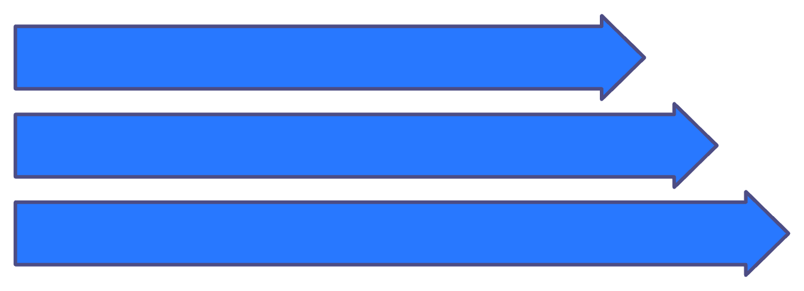
THE GREEDY CHOICE
The key idea is greedy
Pick the unvisited node with the smallest known distance.
Then update, or relax, its neighbours.
Once chosen, its shortest distance is final.
Pick Greedy u
Consider v
Relax via u
Relaxation rule
That choice is safe because all edge weights are non-negative.
if dist[u] + w(u,v) < dist[v], then dist[v] = dist[u] + w(u,v)

Slide 5
THE PROCEDURE
How the algorithm works
01
02
03
04
05
Initialize
Queue
Select
Relax
Repeat
Set source distance to 0; all others to infinity.
Put all nodes in a priority queue.
Pick the node with the smallest distance.
Update its neighbours if a shorter route appears.
Continue until all nodes are visited.

Slide 6
Worked example: start at A
Weighted graph
Distance after each visit
Nodes A, B, C, D, E · Source A
Step | A | B | C | D | E
Start | 0 | ∞ | ∞ | ∞ | ∞
Visit A | 0 | 4 | 1 | ∞ | ∞
Visit C | 0 | 3 | 1 | 6 | ∞
Visit B | 0 | 3 | 1 | 4 | 10
Visit D | 0 | 3 | 1 | 4 | 7
Visit E | 0 | 3 | 1 | 4 | 7
A-B=4 · A-C=1 · C-B=2 · B-D=1
C-D=5 · D-E=3 · B-E=7
Shortest route: A-C-B-D-E · Total weight: 1+2+1+3=7.
Final distances from A: A = 0, C = 1, B = 3, D = 4, E = 7.

Slide 7
IMPLEMENTATION VIEW
Dijkstra's algorithm in pseudocode
for each v: dist[v] ← ∞
previous[v] ← undefined
dist[source] ← 0; Q ← all vertices in min-priority queue
while Q not empty: u ← extract-min(Q)
for each neighbour v of u:
alt ← dist[u] + weight(u,v)
if alt < dist[v]:
dist[v] ← alt; previous[v] ← u
decrease-key(Q,v,alt)
Initialize once; then repeat one loop:
EXTRACT MINIMUM
RELAX NEIGHBOURS
UPDATE QUEUE
The previous array reconstructs the actual shortest path, not only its distance.

Slide 8
EFFICIENCY
Time and space complexity
The next-node data structure changes the running time.
Implementation | Time | Space | Typical use
Array | O(V²) | O(V) | Small or dense graphs
Min-heap / priority queue | O((V + E) log V) | O(V) | Large sparse graphs
Notation — V = number of vertices · E = number of edges
Practical reading — For large sparse graphs, the priority queue avoids repeatedly scanning every vertex.

Slide 9
FINAL CHECK
Limitations and three takeaways
LIMITATION
Three takeaways
No negative edges
Greedy choice: Finalize the nearest unvisited node.
Relaxation: Gradually improve neighbour distances.
Priority queue: Make large graphs faster.
Dijkstra's algorithm does not work with negative edge weights.
Use Bellman-Ford when negative weights are possible.
Generated using [Gamma]

